Slide 1
Clinical Trials Matching and Medical Transcriptions With BERT and XLNet
Sandhya Arumugam Karunanithy & Steve Cho
CS 577
Final Project Presentation

Slide 2
INTRODUCTION
GOAL: To develop a Natural language model that can effectively match patients to suitable clinical trials based on patient’s profiles and Clinical trial descriptions.
BREAKDOWN OF TASKS:
• To fetch top ’k’ patient profiles which are suitable for given clinical trial description using BERT.
• To identify medical symptoms based on the patient's descriptive text using XLNet.

Slide 3
DATASET-BERT
1. Used Synthea [1-https://github.com/synthetichealth/synthea] to generate synthetic patient profiles.
2. Fetched 50 clinical trials data from the ClinicalTrials.gov(database of clinical trials conducted in the US) (publicly available) for the following medical conditions.
Diabetes
Cancer
Alzheimer’s disease
Hypertension

Slide 4
DATASET-XLNet
Identifying Medical Symptoms:
Dataset Content → CSV file of an overview of entire recordings
Using ‘phrase’ and ‘prompt’ labels.
Phrase is a direct translation of part of the audio recording into descriptive text of a symptom.
Prompt is a medical symptom, and there are 25 different medical symptoms.

Slide 5
TECHNICAL APPROACH - BERT
Data extraction & Data pre-processing.
Loaded BERT Model and computed BERT embeddings
Calculated Cosine similarities between the patient conditions and trial descriptions
Filtered clinical trials and recommended top 3 trials for each patient.

Slide 6
TECHNICAL APPROACH - XLNet
Use pre-trained XLNet tokenizer imported from transformers.
For the data set, we converted input ids, attention masks, and encoded labels into lists of tensors.
Use pre-trained XLNet model for sequence classification provided with given 25 labels.
Train the model to obtain accuracy, loss, and validation accuracy

Slide 7
EVALUATION - BERT
Since we did not have ground truth data to compare the recommended trials, we indirect evaluation:
By analysing the diversity of the recommendations.
By the distribution of trial features (study types and enrollment sizes) within the recommended trials.
We also manually assessed the diversity of the recommendations for some patient profiles and ensured that patients with varying needs and preferences have access to a variety of clinical trials.

Slide 8
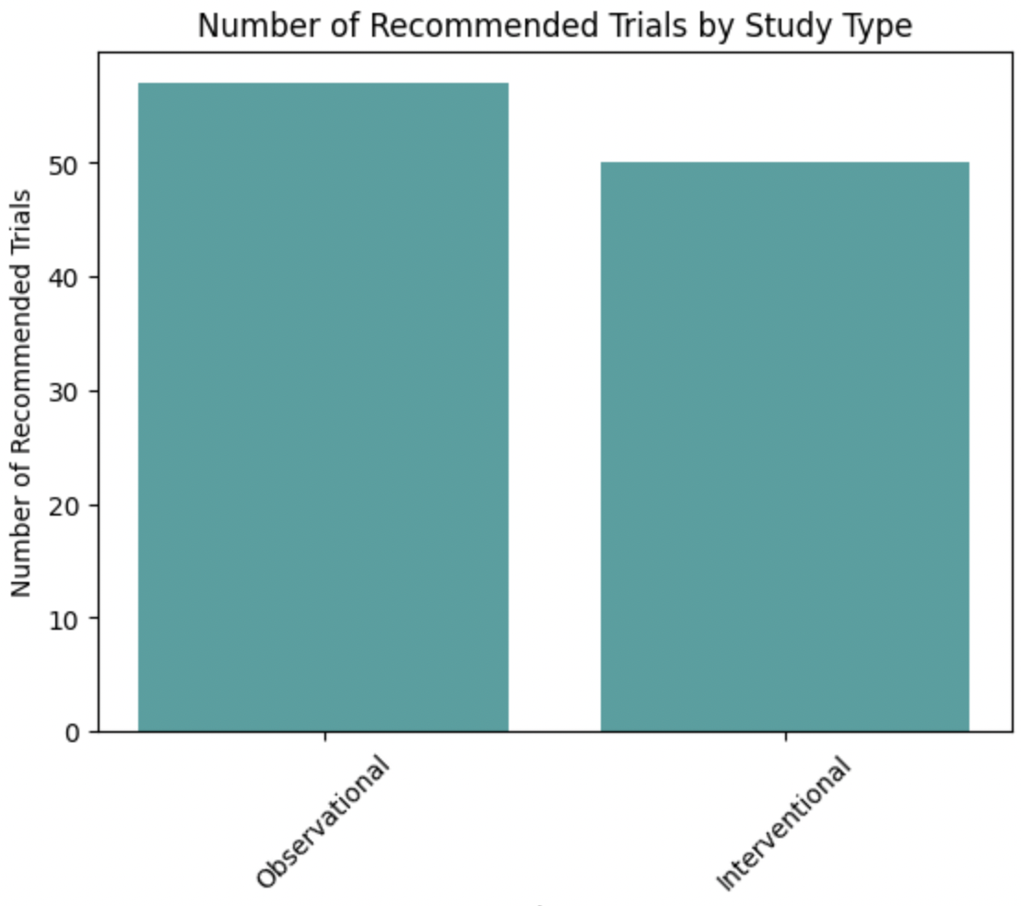
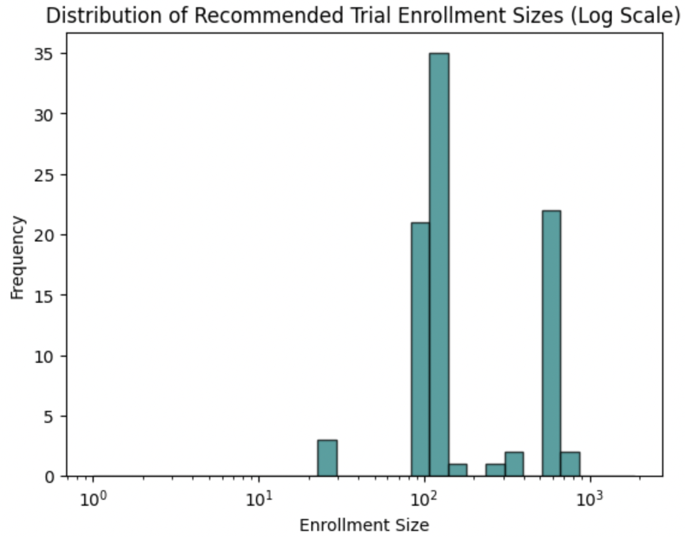
EVALUATION - BERT
Recommended trials across study types: -Trials are matched with patient profiles
-Each patients gets top 3 recommendations -Graph shows overall number of observational & interventional trials recommended for patients
Only a portion of overall enrollments are recommended compared across trials

Slide 9
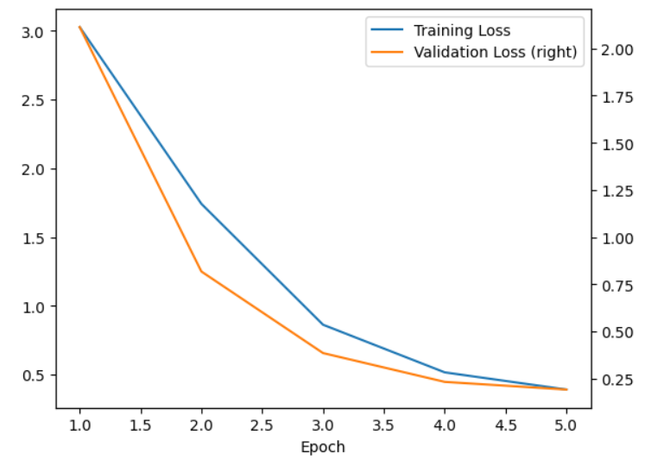
Evaluation on Loss - XLNet

Slide 10
Evaluation - XLNet
XLNet Model Training and Testing Result: 5 Epoch
 | Accuracy(%) | Loss
Training | 91.0 | 0.39
Validation | 92.85 | 0.19
Testing | 89.32 | -

Slide 11
REFERENCES
Tsang, Sik-Ho. “Review - Xlnet: Generalized Autoregressive Pretraining for Language Understanding.” Medium, Medium, 2 July 2022, https://sh-tsang.medium.com/review-xlnet-generalized-autoregressive-pretraining-for-language-understanding-39e48bed2337.
LIANG, Xu. “What Is XLNet and Why It Outperforms Bert.” Medium, Towards Data Science, 31 May 2020, https://towardsdatascience.com/what-is-xlnet-and-why-it-outperforms-bert-8d8fce710335.
Ghag, Shanay. “Using XLNet for Sentiment Classification.” Medium, The Startup, 17 June 2020, https://medium.com/swlh/using-xlnet-for-sentiment-classification-cfa948e65e85.
Kudo, Taku, and John Richardson. “Sentencepiece: A Simple and Language Independent Subword Tokenizer and Detokenizer for Neural Text Processing.” ArXiv.org, 19 Aug. 2018, https://arxiv.org/abs/1808.06226.
Matching patients to clinical trials using semantically enriched document representation. Journal of Biomedical Informatics. Retrieved April 1, 2023, from https://www.sciencedirect.com/science/article/pii/S1532046420300344
Natural language processing systems for capturing and standardizing unstructured clinical information: A systematic review. Journal of Biomedical Informatics. Retrieved April 1, 2023, from https://www.sciencedirect.com/science/article/pii/S1532046417301685
Trial prospector: Matching patients with cancer ... - sage journals. (n.d.). Retrieved April 1, 2023, from https://journals.sagepub.com/doi/pdf/10.4137/CIN.S19454

